Slide 1


UKCRC Tissue Directory and MIABIS Implementation
Matt Styles
15th March 2018

Slide 2


UKCRC Tissue Directory
UK Clinical Research Collaboration – aims to make clinical research easier. Collaboration between academia, NHS, pharma, regulatory bodies, patients
Funded the creation of a central tissue directory with aims of making better use of collected samples, and preventing duplication of collection
UKCRC partner funders agreed to work towards requiring applicants to:
Justify the need for creating new collections
Seek generic consent
Describe how they comply with good practice
Register with the Tissue Directory and make information public

Slide 3
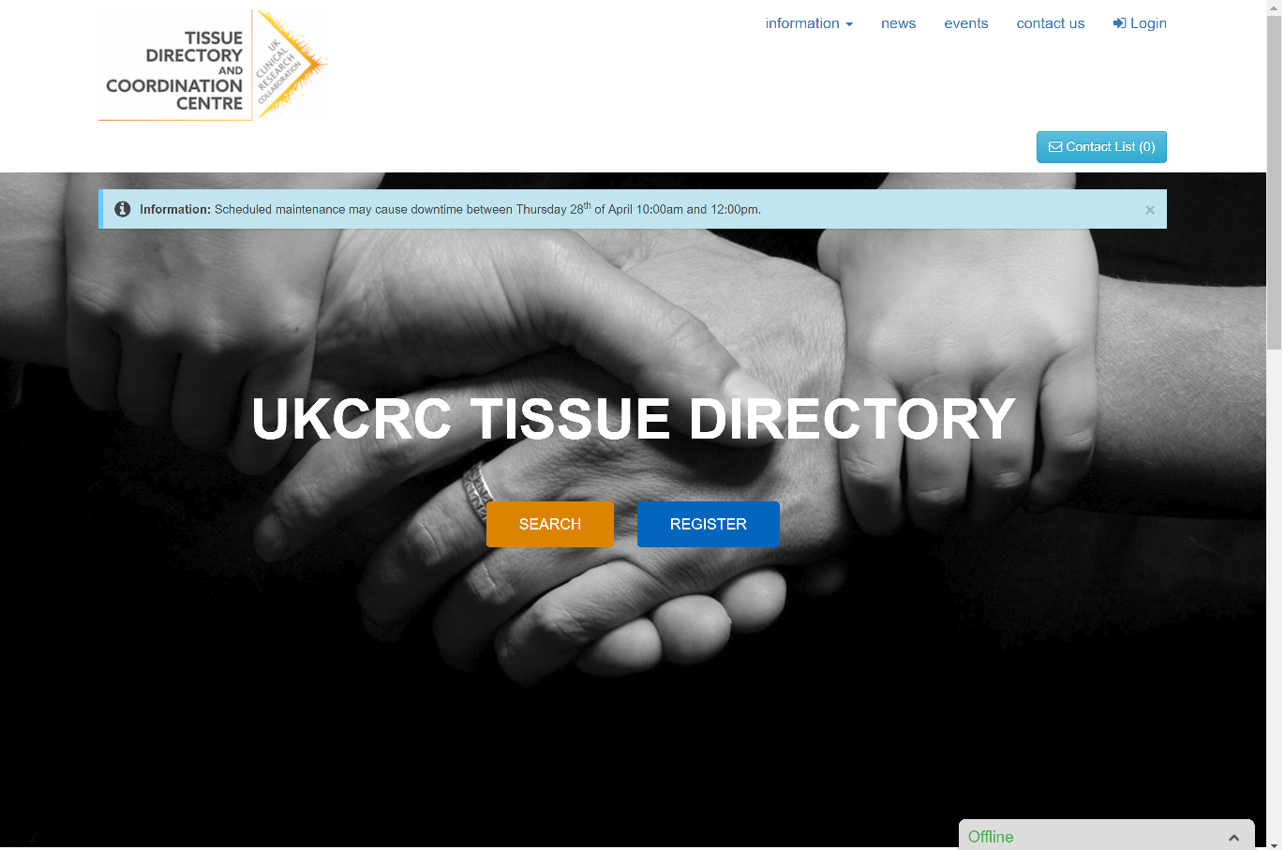

Slide 4
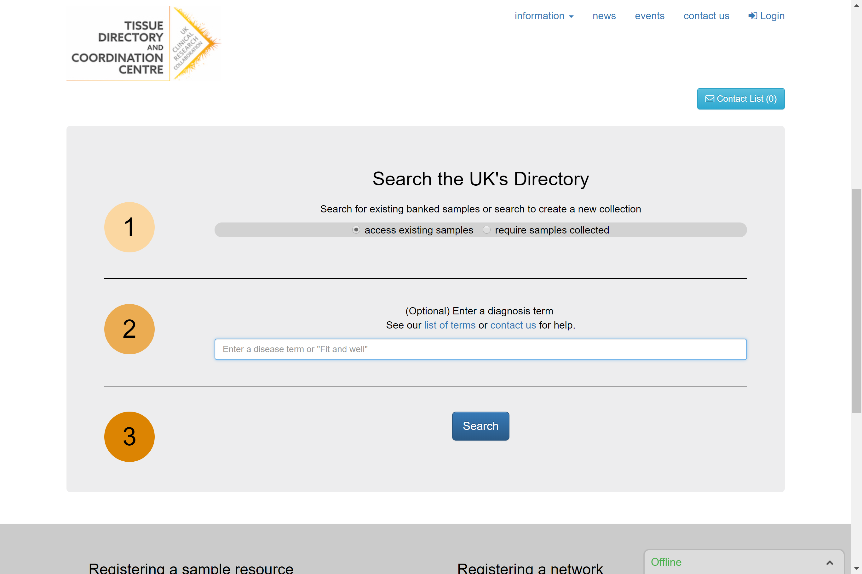

Slide 5
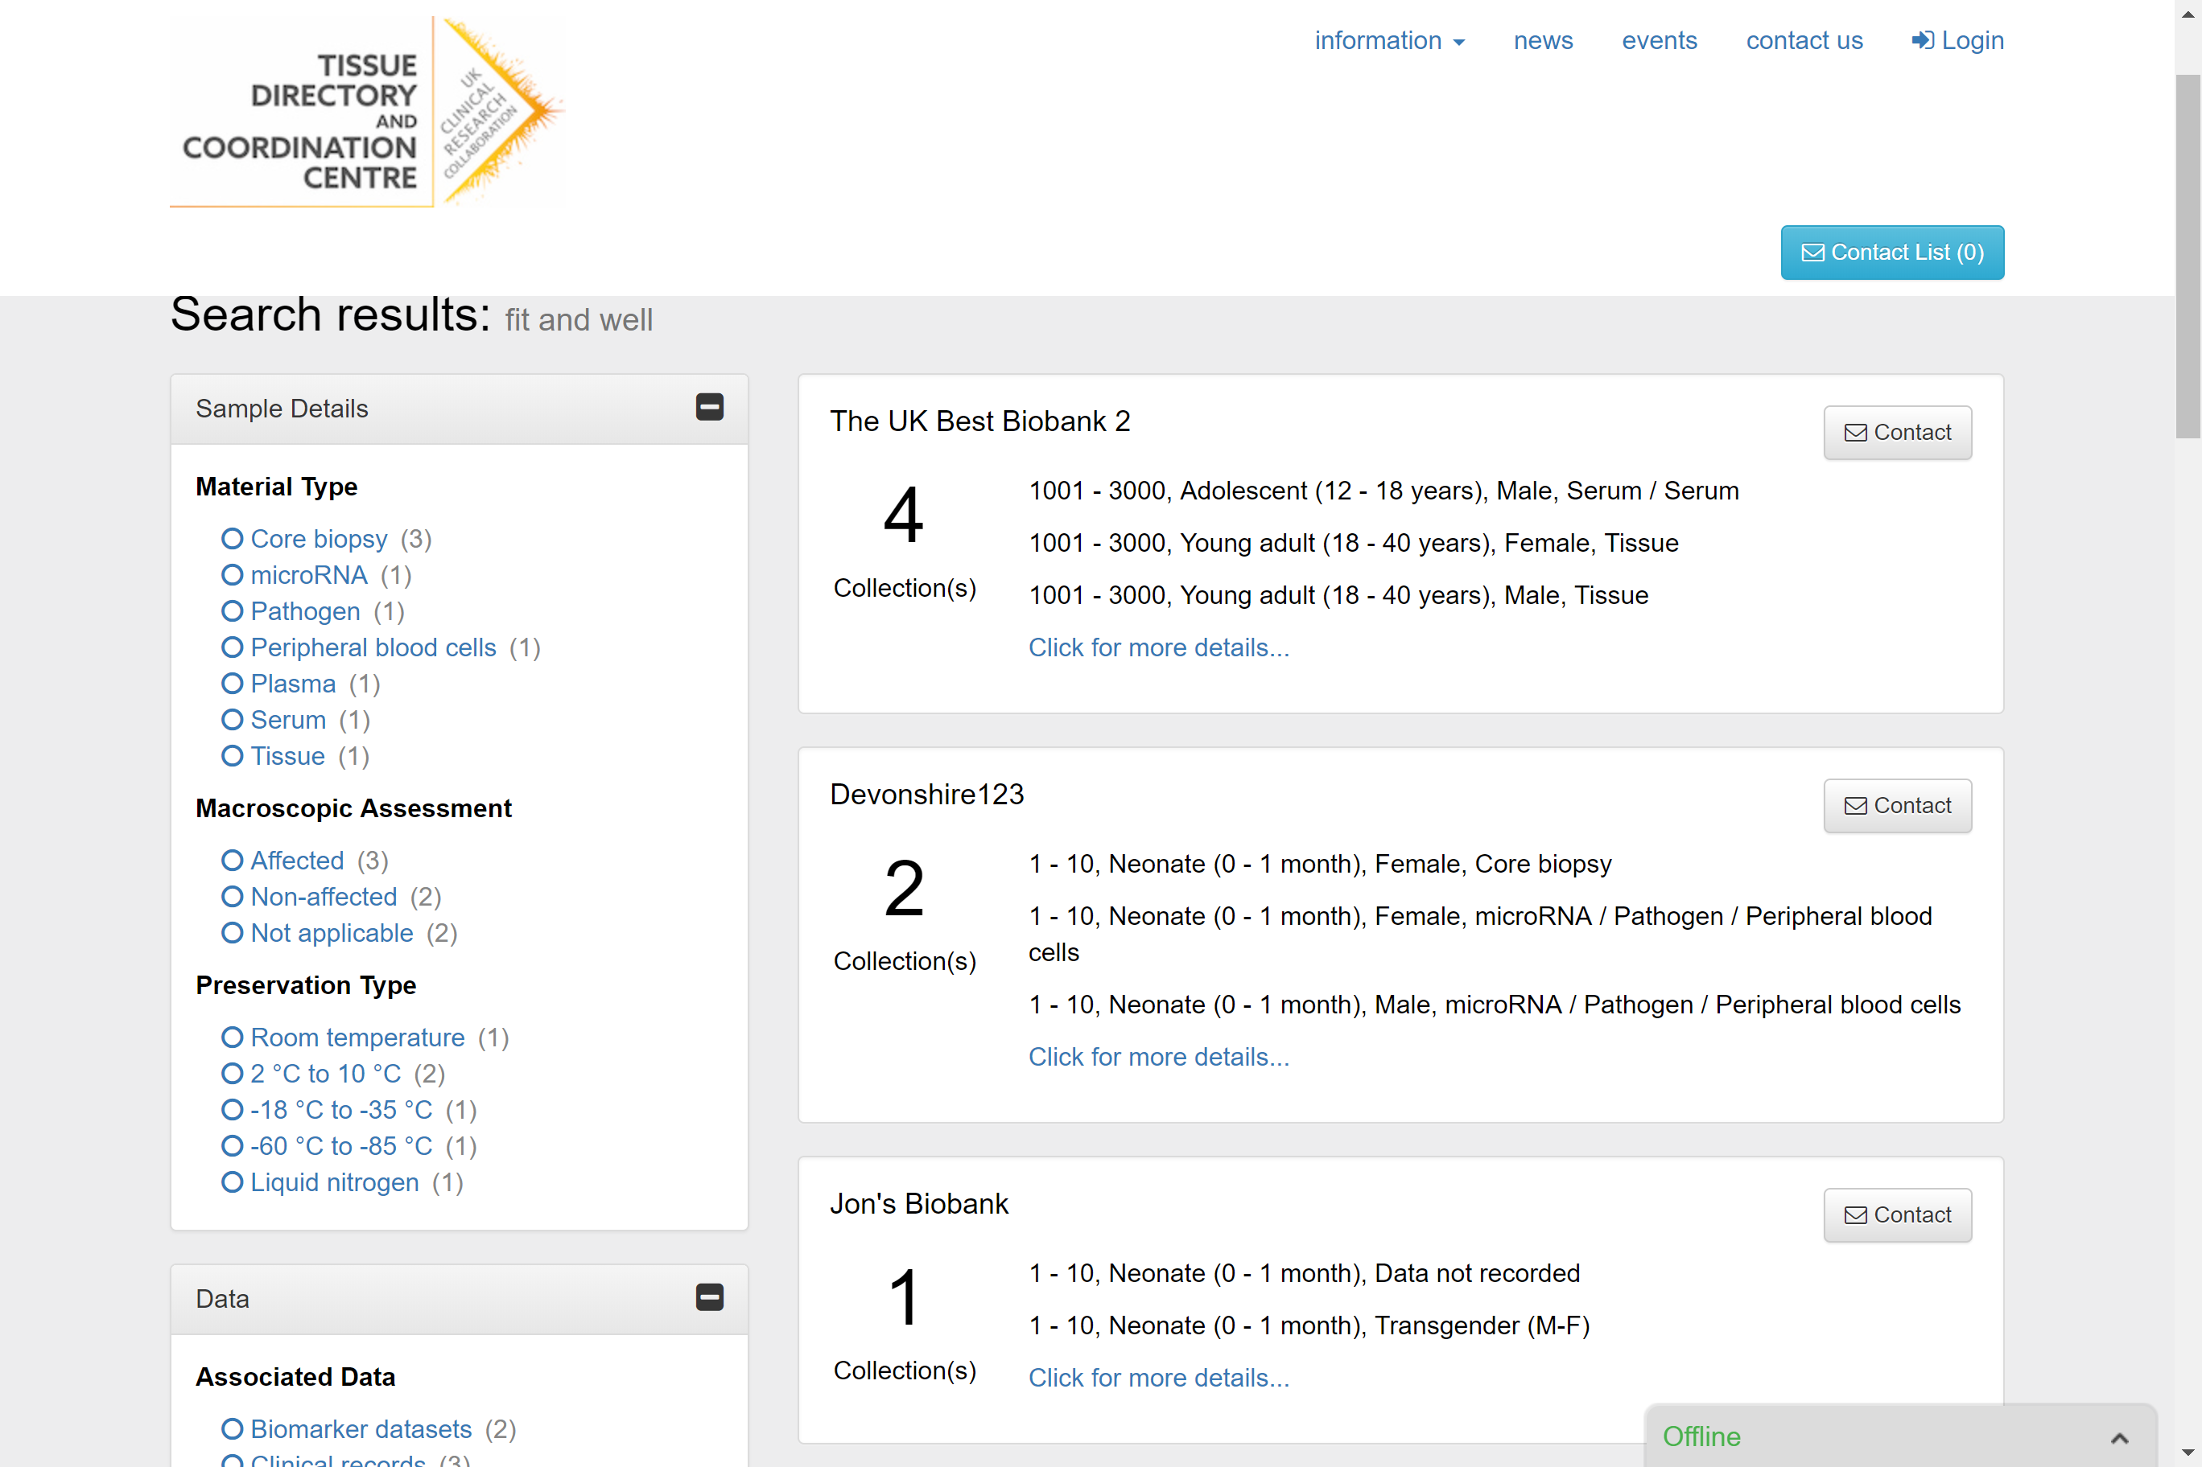

Slide 6
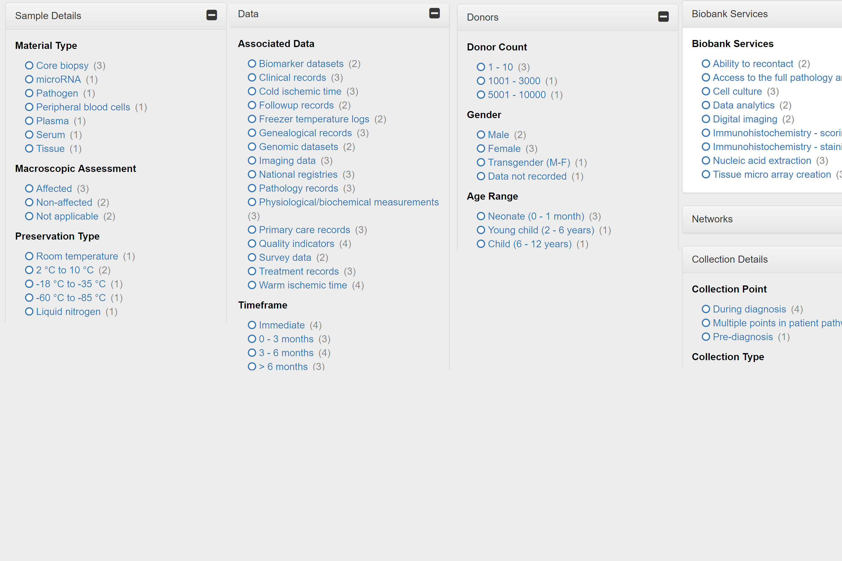

Slide 7
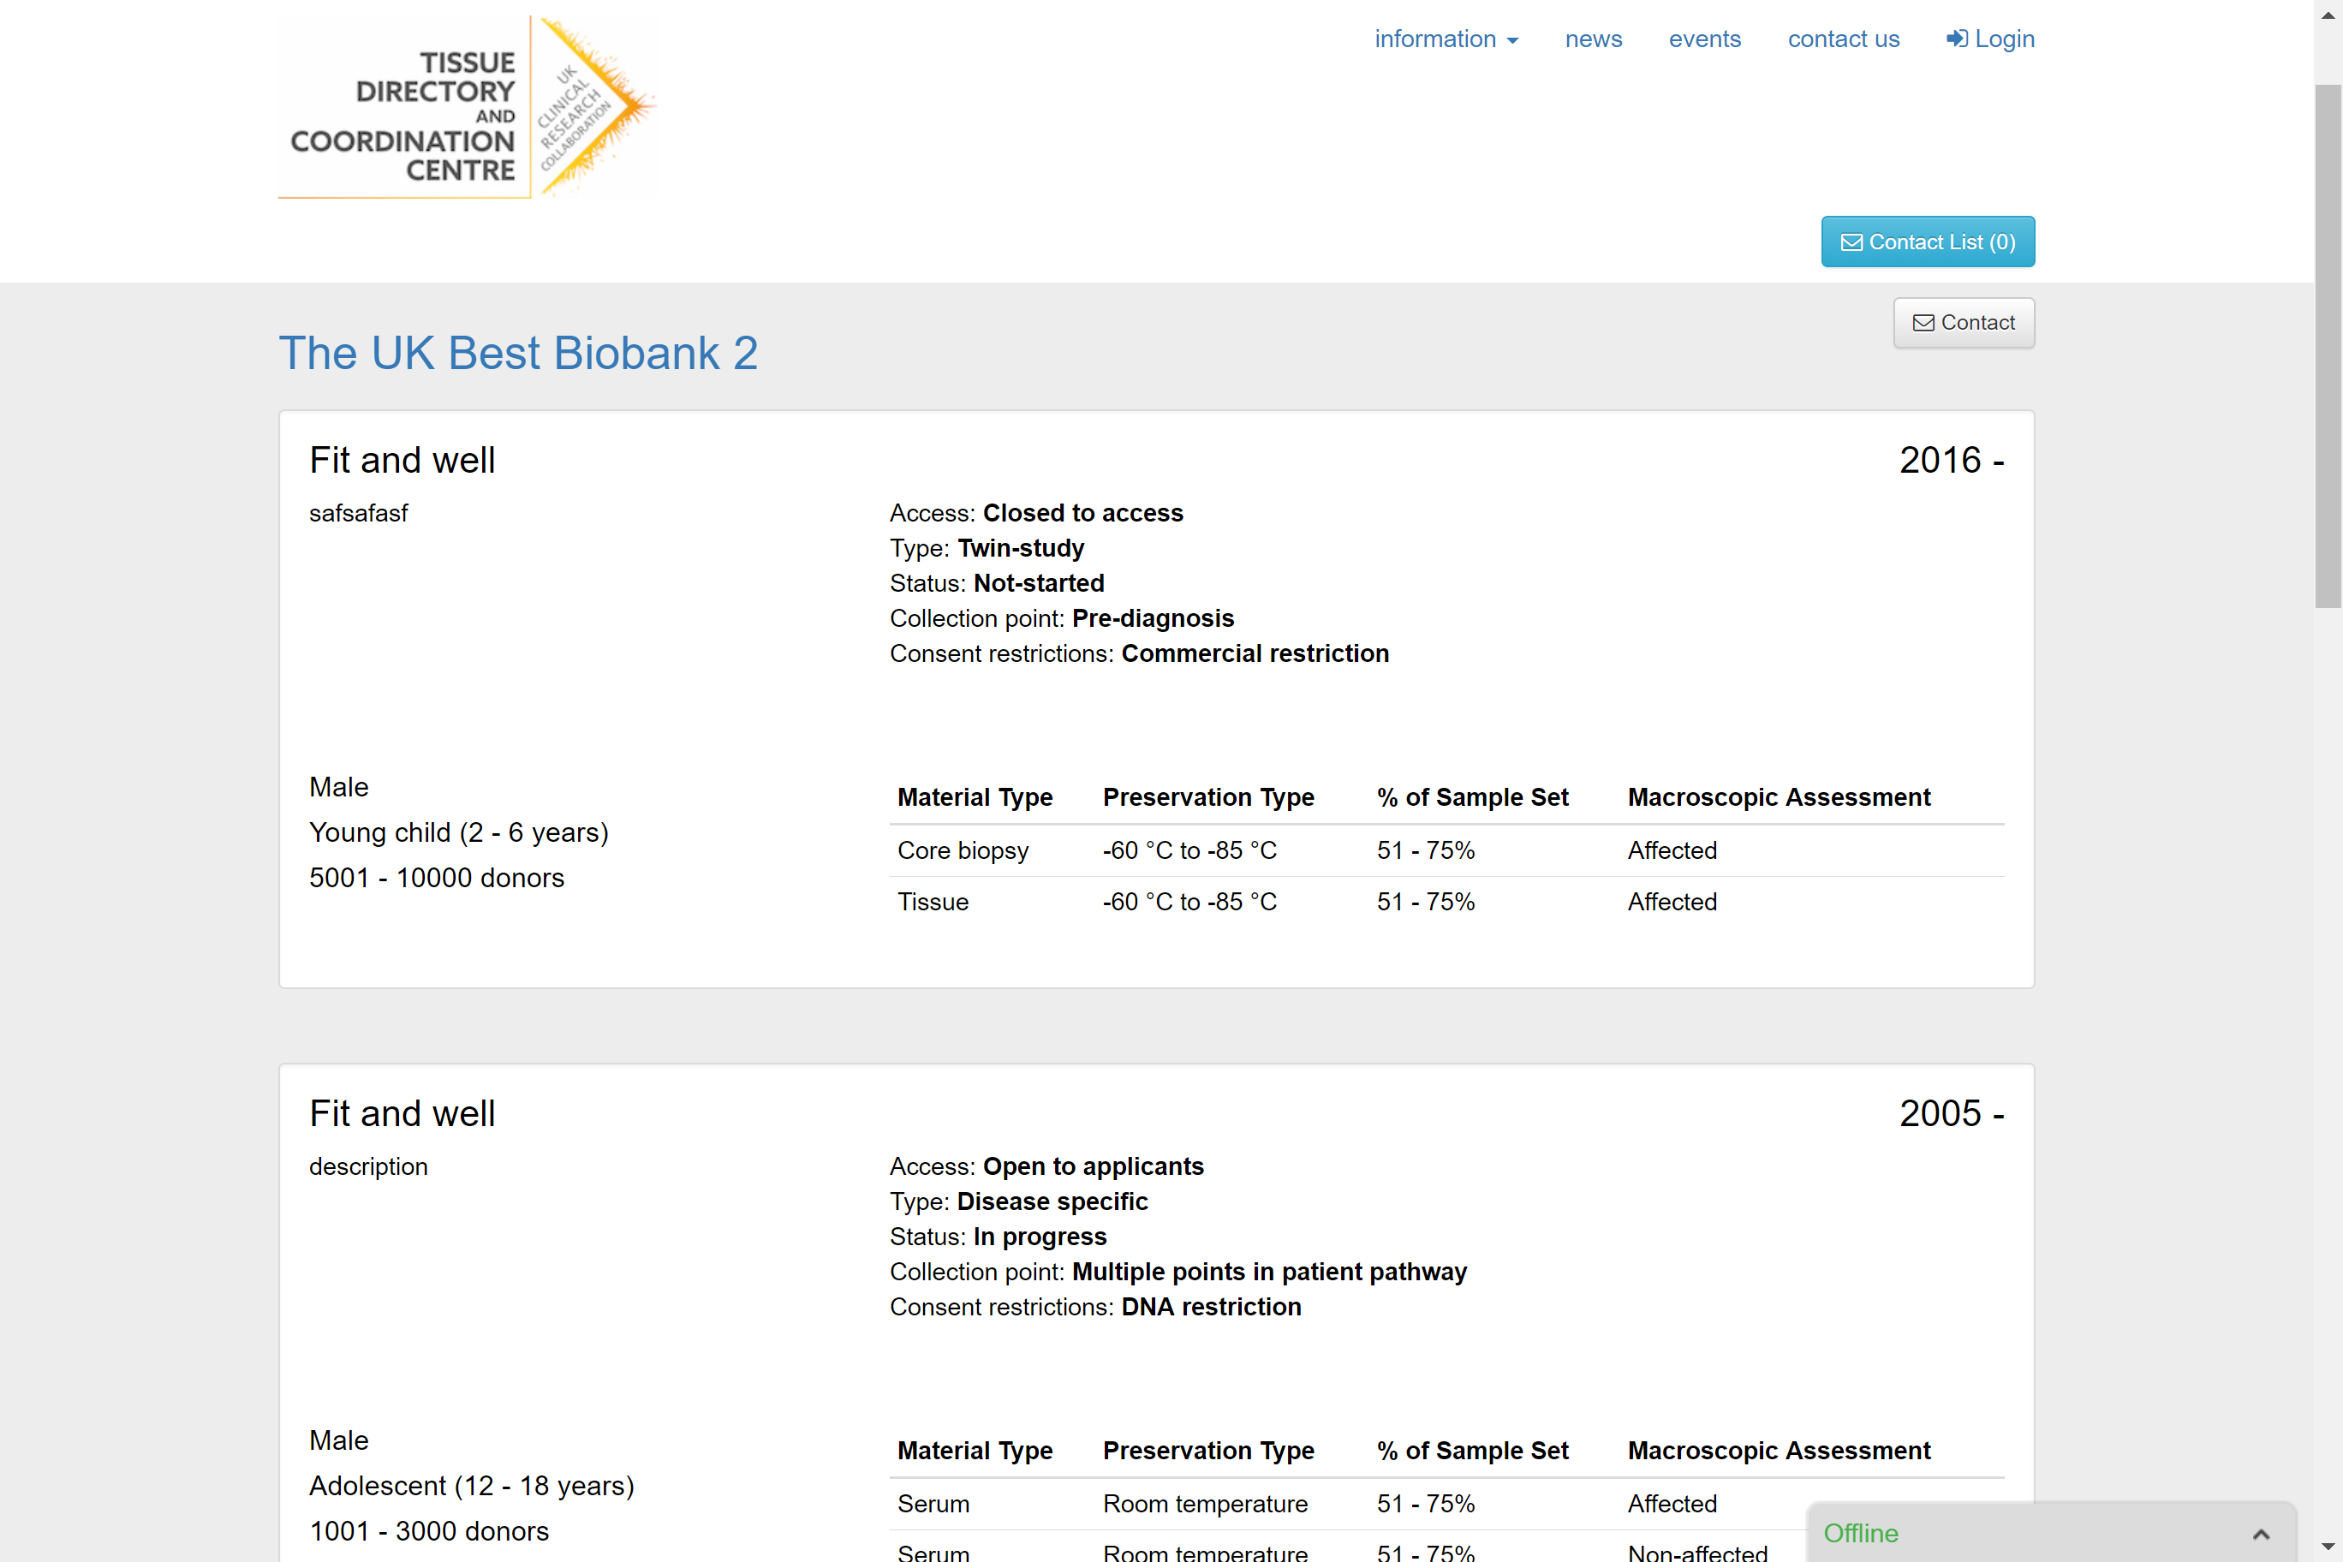

Slide 8
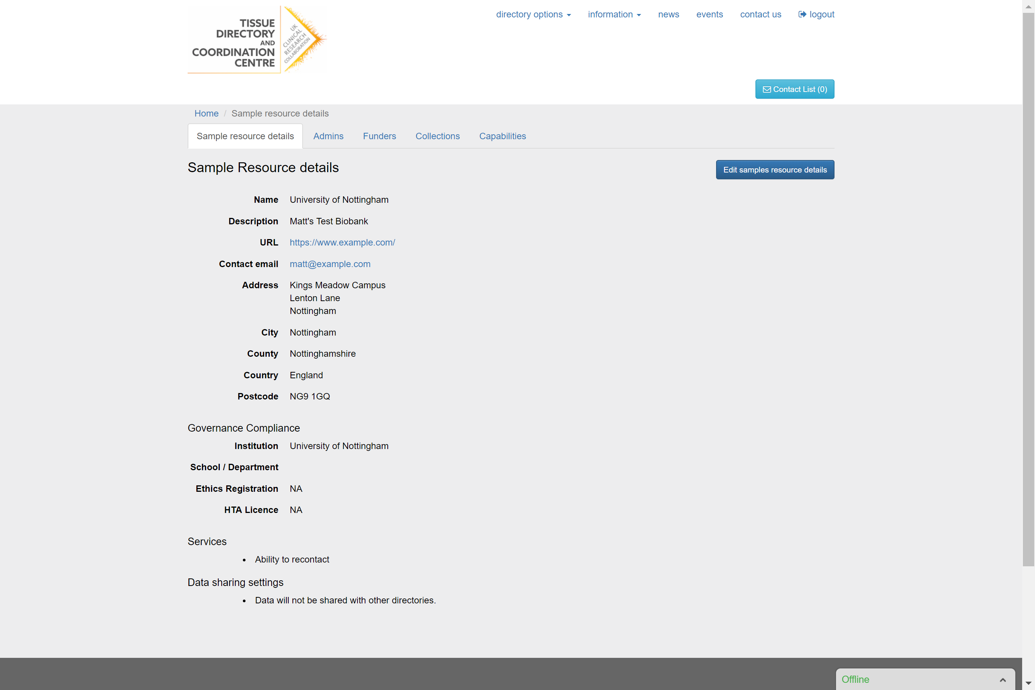

Slide 9
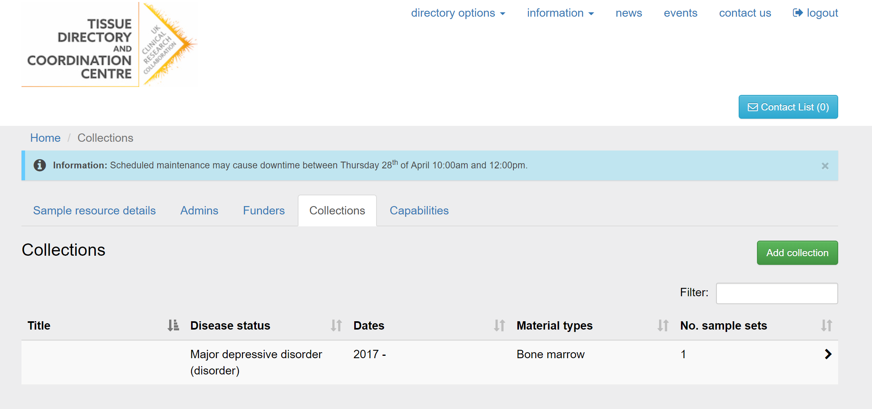

Slide 10
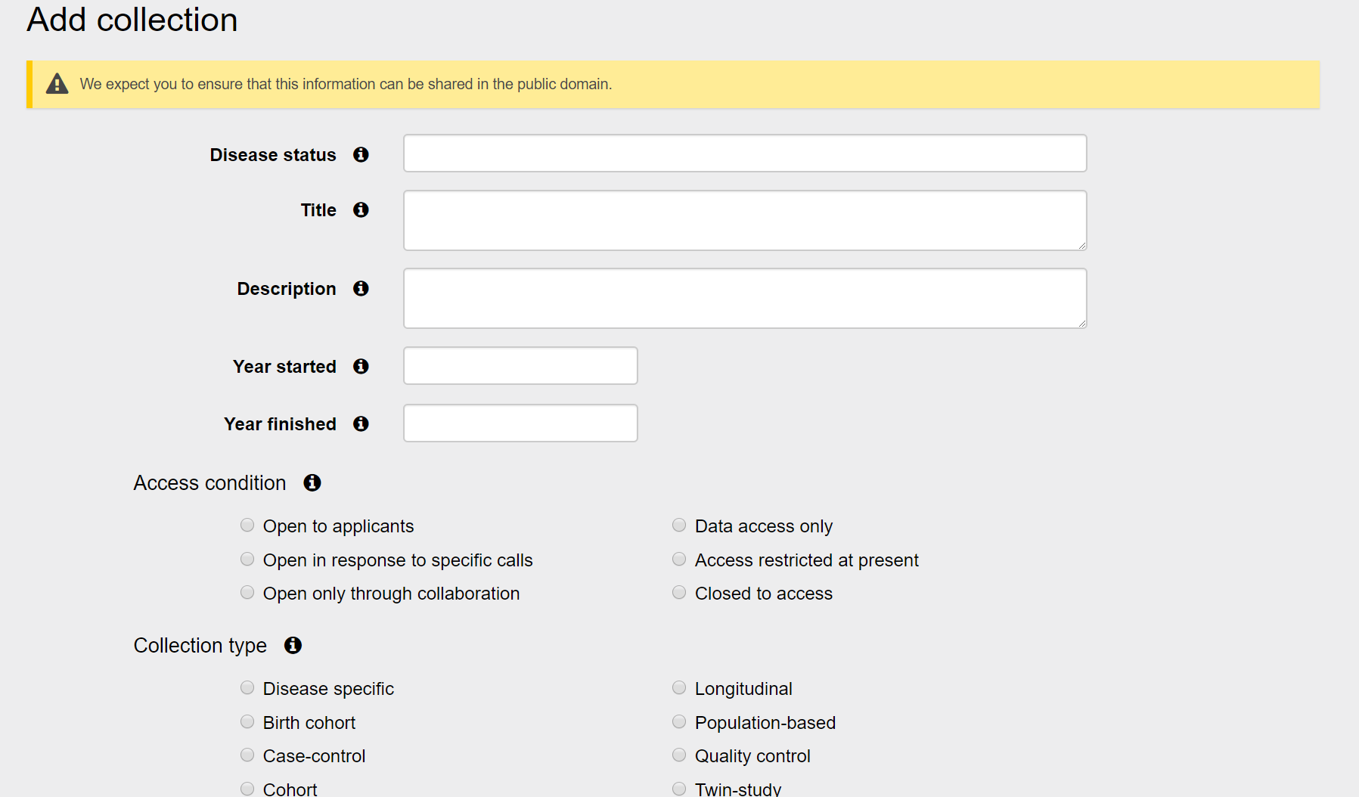

Slide 11
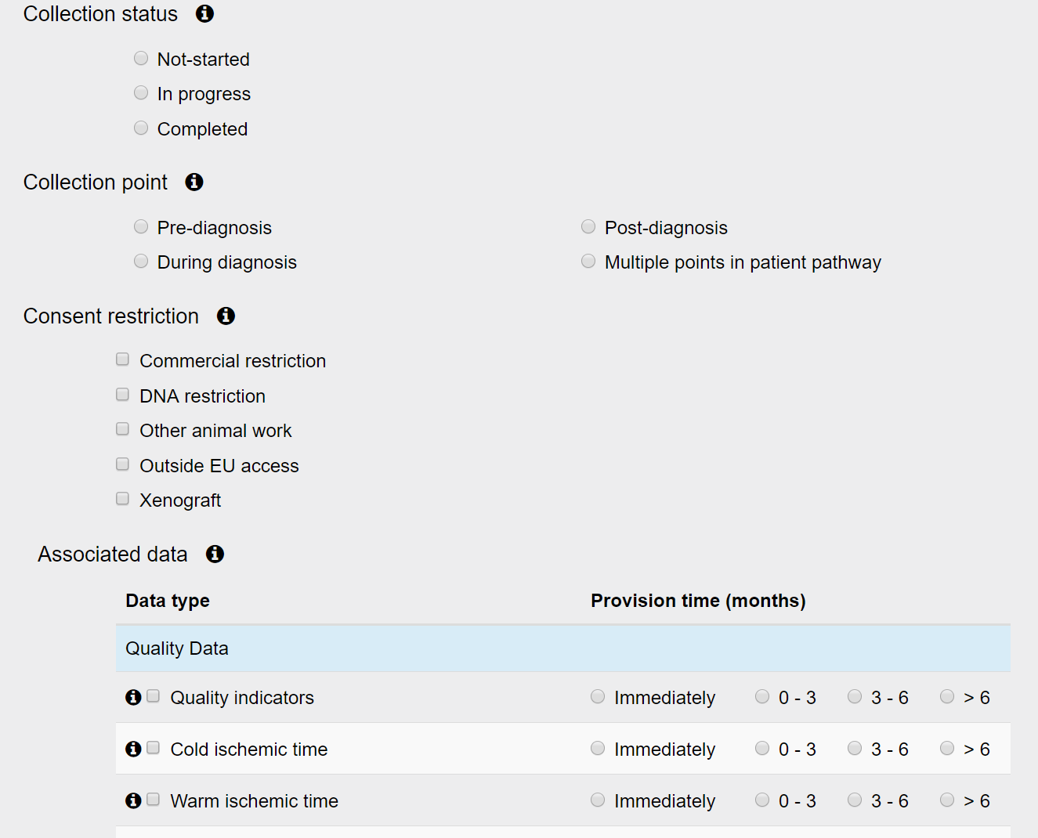

Slide 12
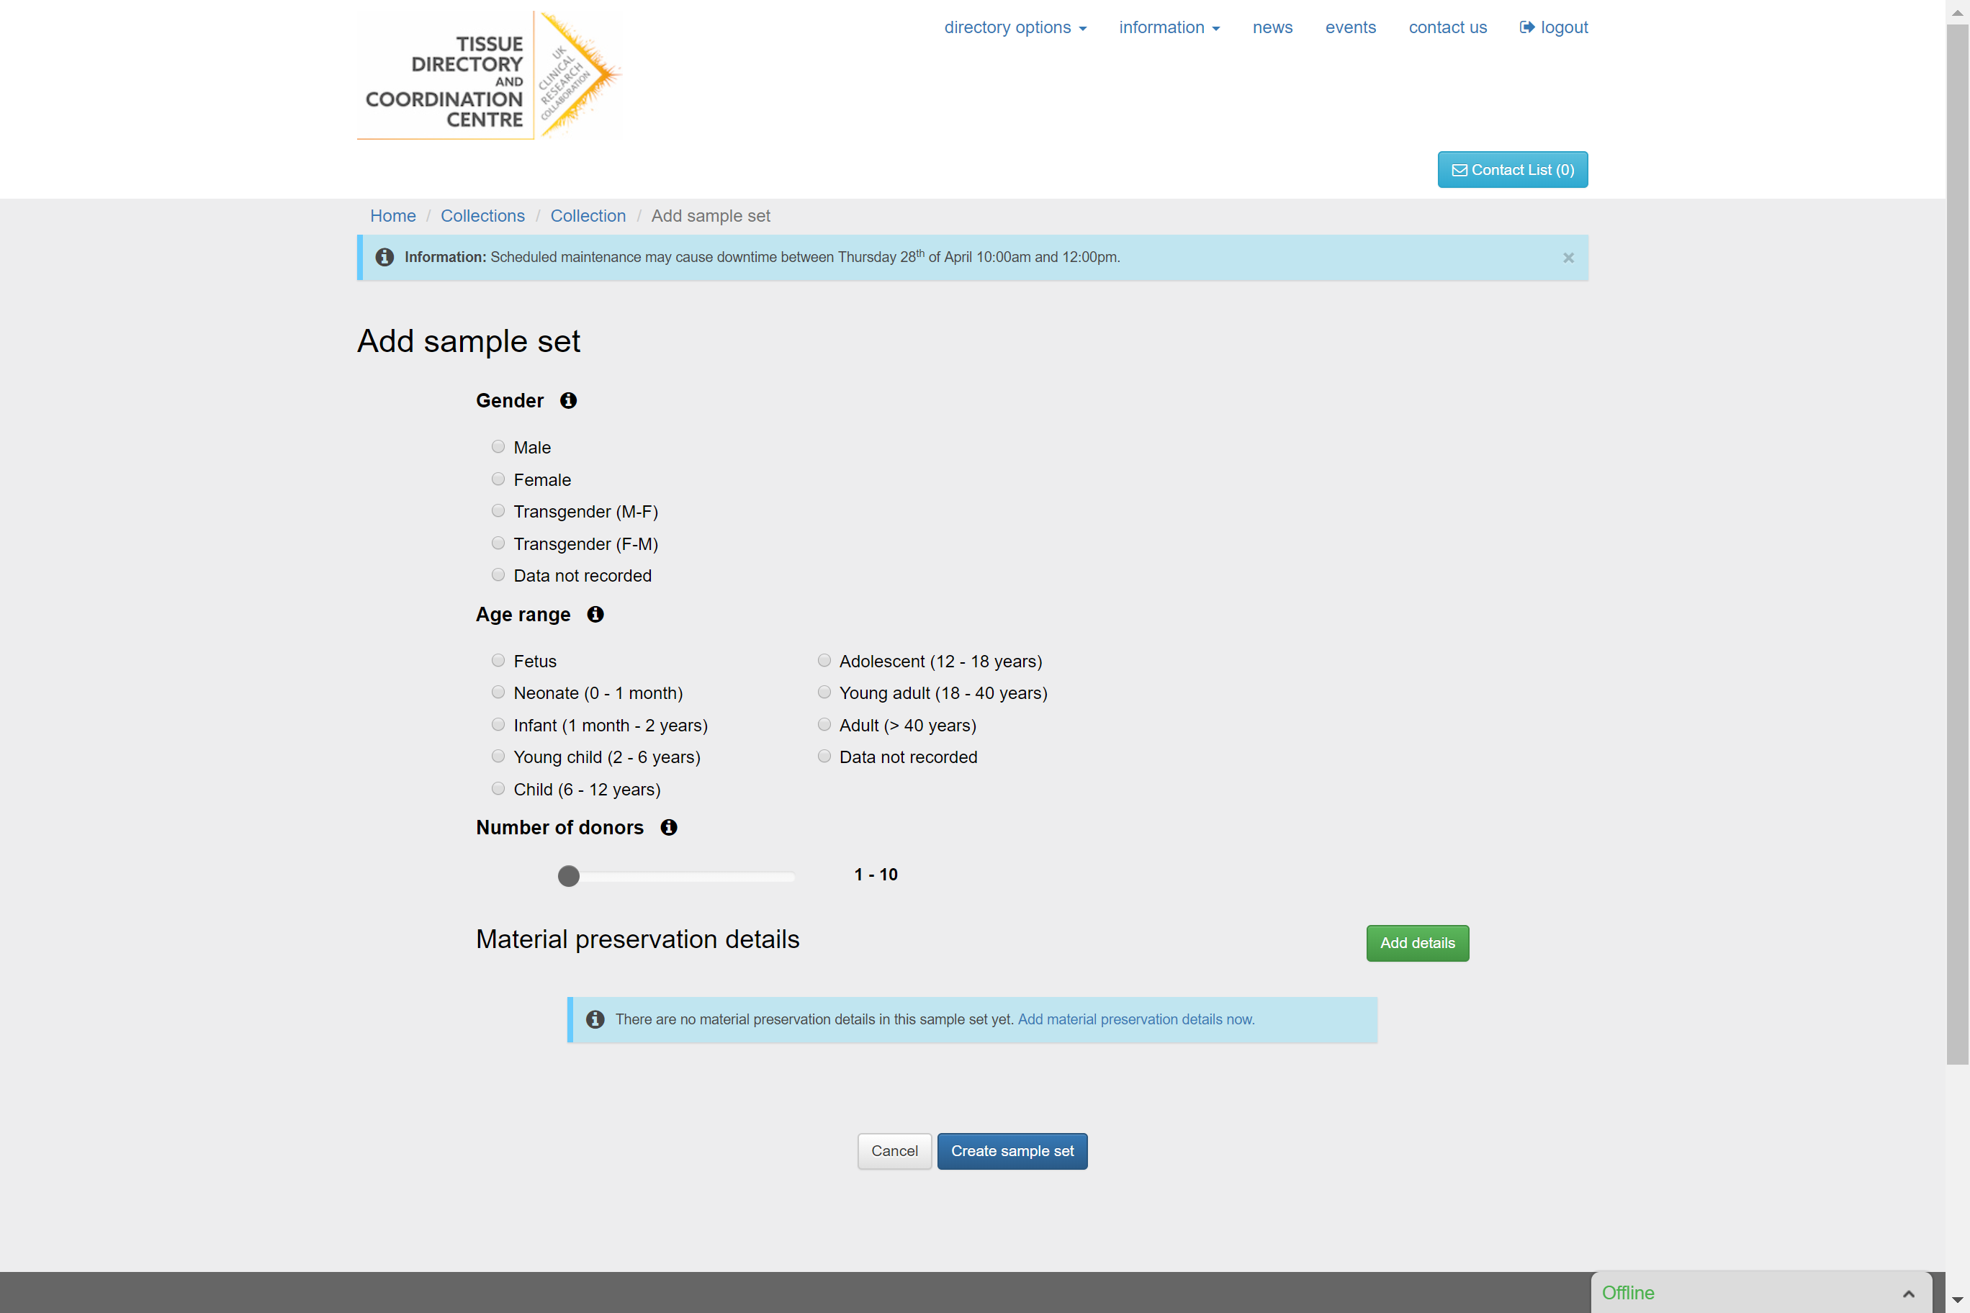

Slide 13
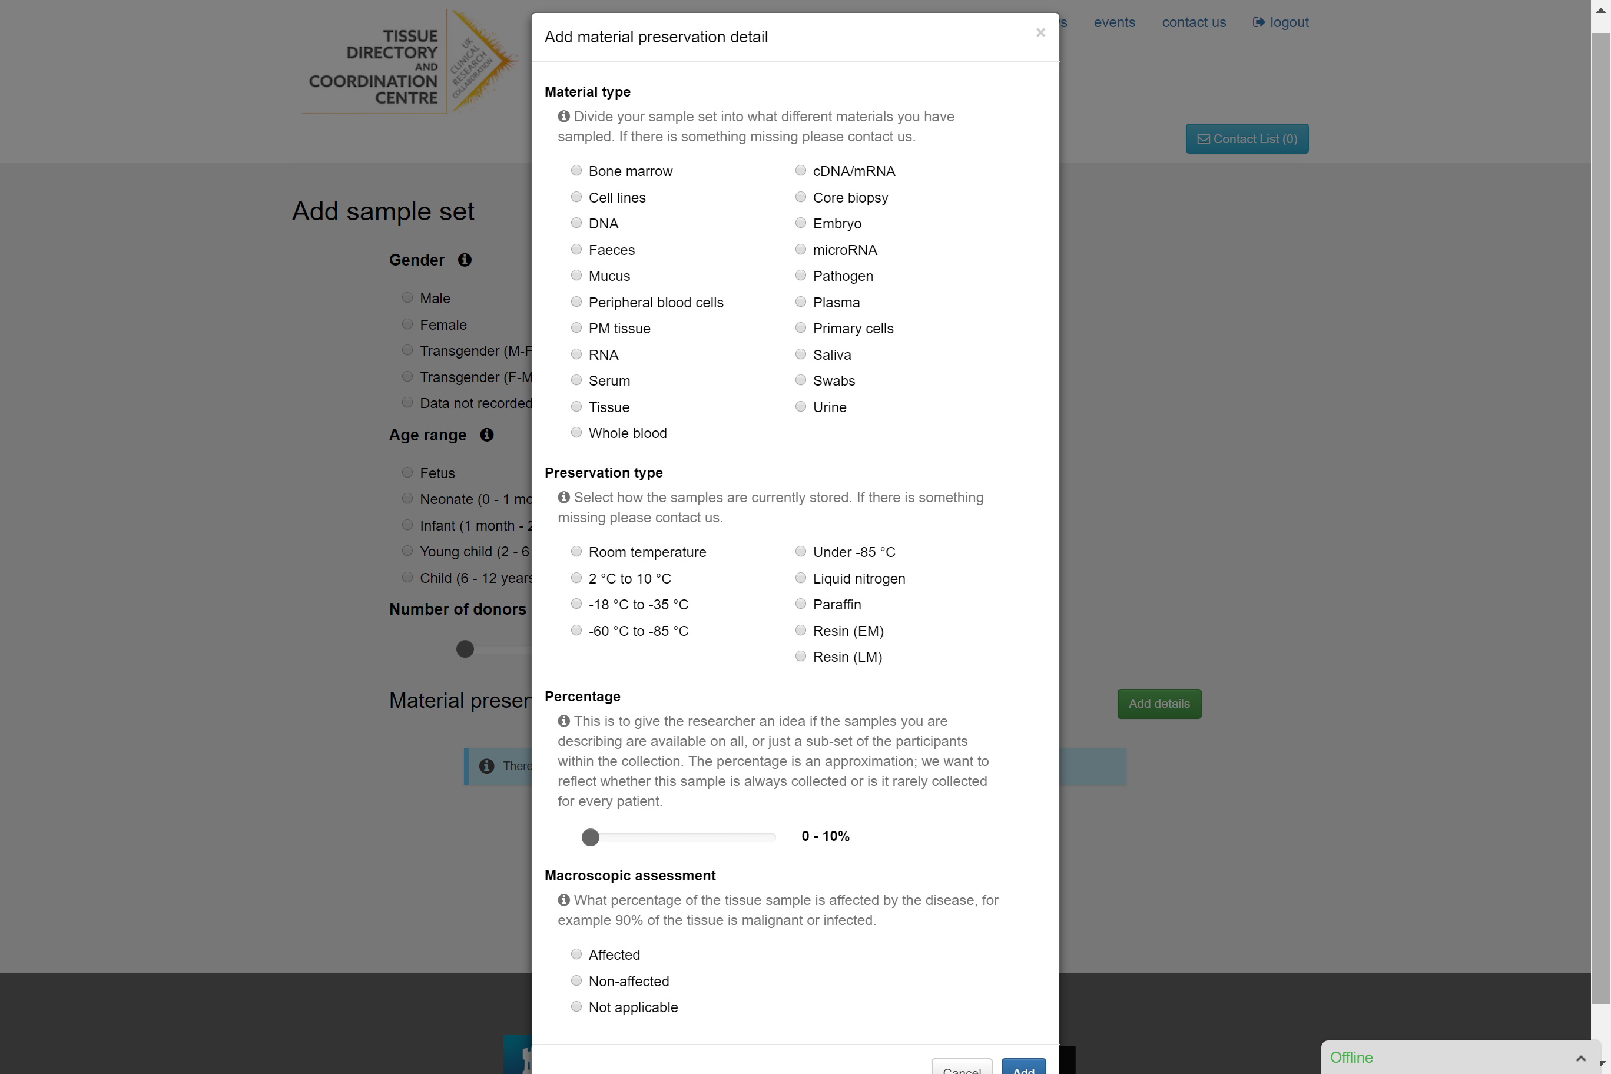

Slide 14
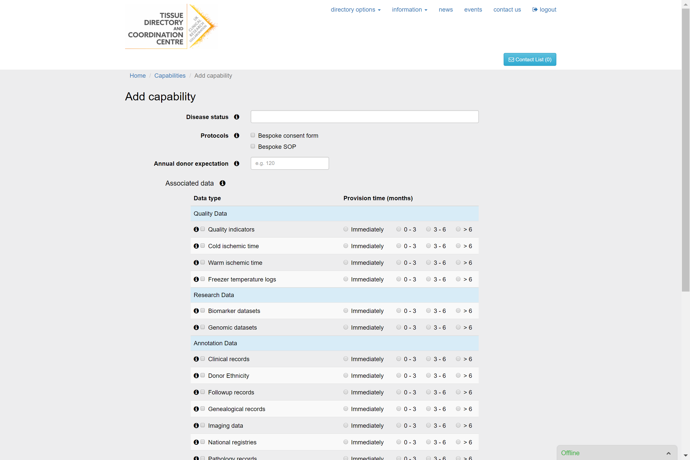

Slide 15
How’s the Directory doing?
We have around 170 biobanks registered out of an estimated 250
Data for around 400 collections
Covers 1million-2.3million sample donations
UKCRC funders now require registration in order to provide funding
Just started looking at levels of ‘profile completion’
Aim now is for us to ‘raise the bar’ for what associated data is collected, provided, and made publicly available

Slide 16
Tissue Directory API Proof-of-Concept
Further funding granted for creation of an API which allows ‘bulk upload’ of collection and sample data
PoC developed and is in early testing with software vendors
Allows bulk upload of diagnoses, treatments, and samples
Built on a microservices architecture designed to be highly scalable
Deployed to the cloud to allow greatest elasticity
Effectively our ‘Phase 2’ of the directory project, with ‘Phase 3’ being further development, getting it live, and using the main directory data source

Slide 17
MIABIS v2.x Implementation
We have a specific goal of avoiding duplication so standards are key!
https://www.biobankinguk.org/standards
Directory and API use MIABIS Lists for:
Material Type
Collection Type
Storage Temperature
Close to MIABIS Structured Data in the Directory for:
Contact Information (Missing named contact and phone number)
Researcher information (Missing ORCID, not collected per collection)
Collections (Disease data not all fields compulsory), SNOMED-CT
Don’t implement the proposals – Donor, Sample, Vendor
We are supportive and keen to do more
Bioschemas for our Directory web view seems like an obvious next step

Slide 18
MIABIS v2.x / Bioschemas Challenges
Data availability
Challenging collecting due to distributed nature, and encouragement for retrospectively providing or finding data
Categorisations not matching, e.g. Sex – UKCRC [currently] offers two Trans options; these aren’t options in MIABIS Lists
GDPR, e.g. MIABIS specifies Sample Donor Personal Identification Number, Contact Information
Bioschemas for APIs which might expose data in different formats, particularly where size of data may be very large
Bioschemas mapping to aggregate data, including e.g. MIABIS
I’m still new to this - ~3 weeks in!

Slide 19
Questions
Matt.Styles@nottingham.ac.uk
contact@biobankinguk.org

